Slide 1
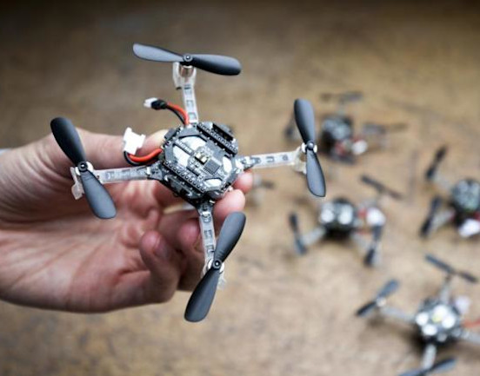
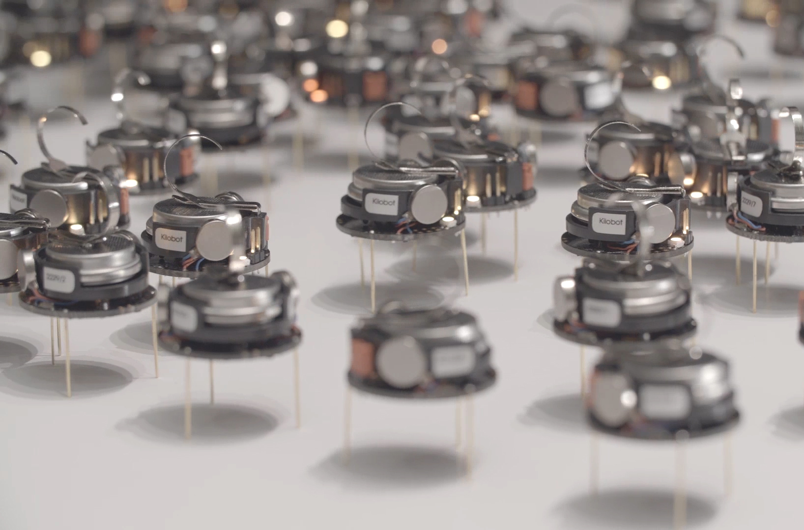
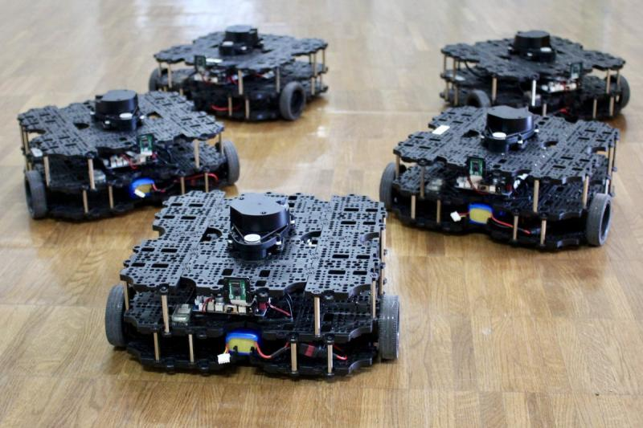

ECE693H, Spring 2025: Multi-robot System Design
“Perception 1”
Dr. Daniel Drew

Slide 2
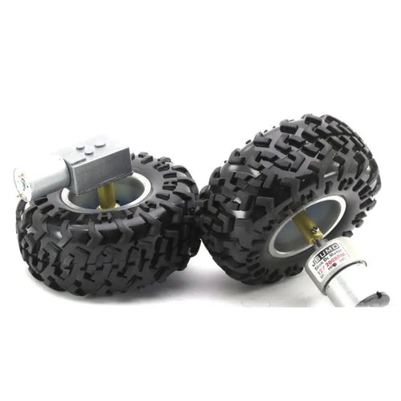
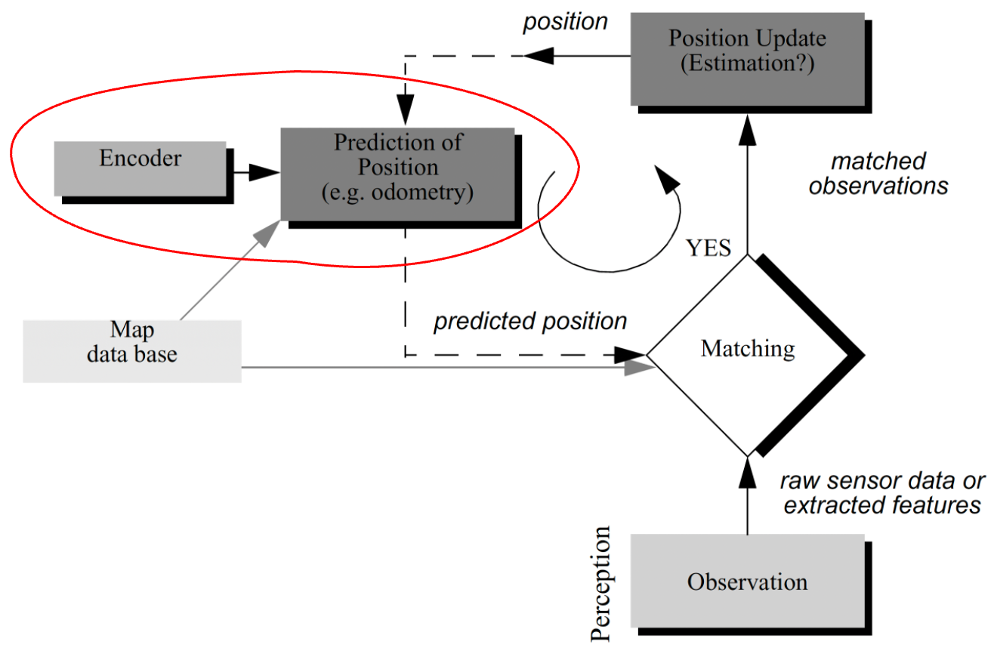
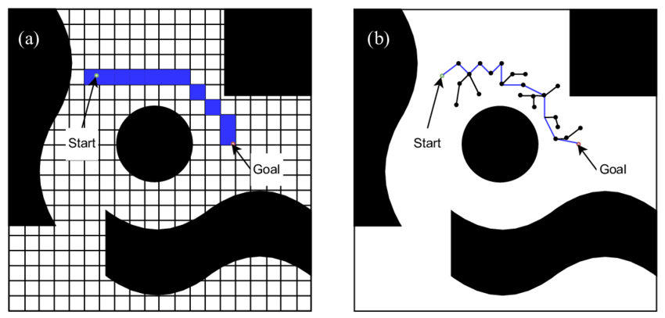
Action Recap
Localization / Odometry
Action
Ascending the stack from the motor
Path and Motion Planning
Electromagnetic motors
Motor gearing and mechanics
Motor driver electronics
Encoders

Slide 3
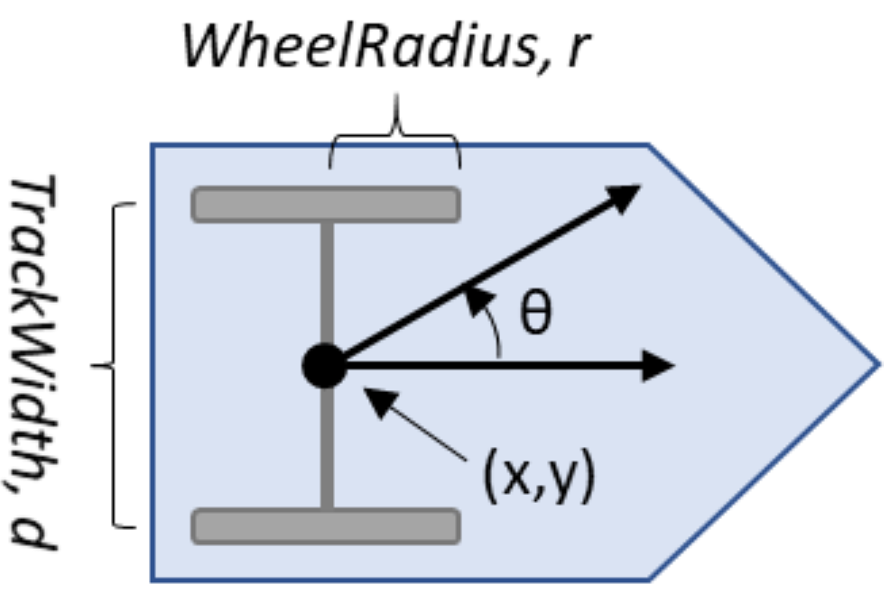
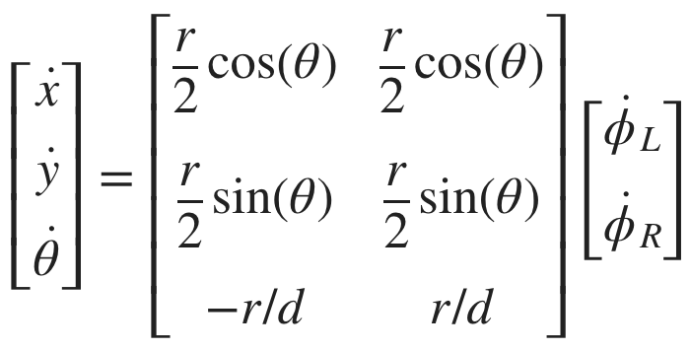
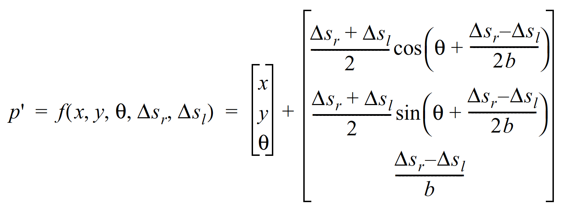
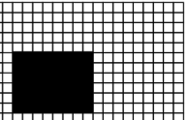
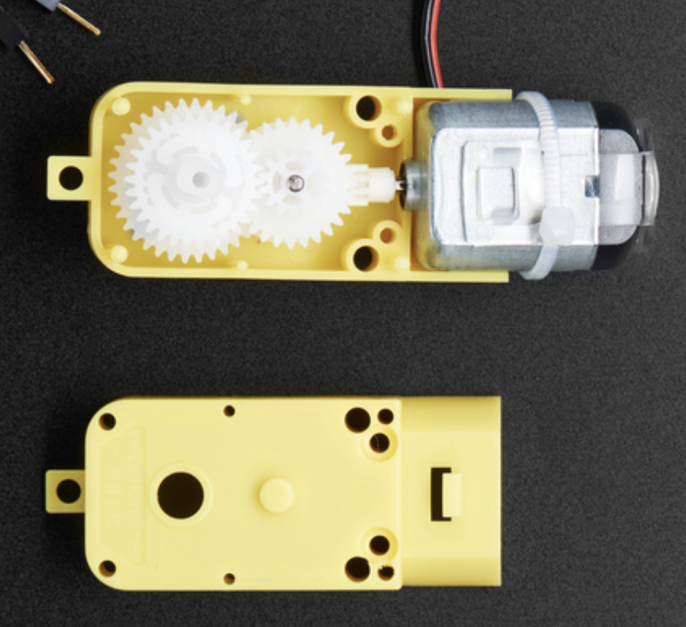
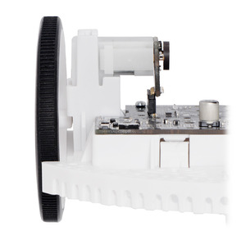
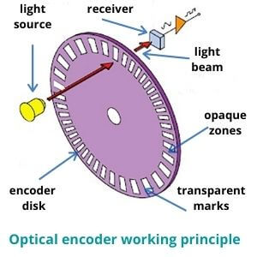
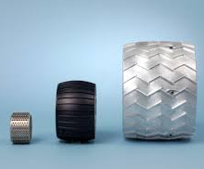

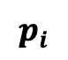
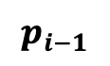

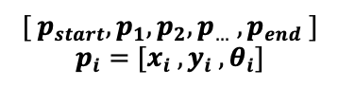
Action: End-to-End Overview
series of poses
$${[ p}_{start}, p_{1},p_{2},p_{…} , p_{end} ]$$
$$p_{i}=[x_{i} , y_{i} , θ_{i}]$$
$$p_{i−1}$$
Path Planning
$$p_{i}$$
Kinematics
desired $Δs_{r} , Δs_{l}, θ$
physical
parameters
$$Δs=\frac{Δenc}{CPR∗gr}∗c_{wheel}$$
Motor
Wheel
Encoder
Odometry

Slide 4
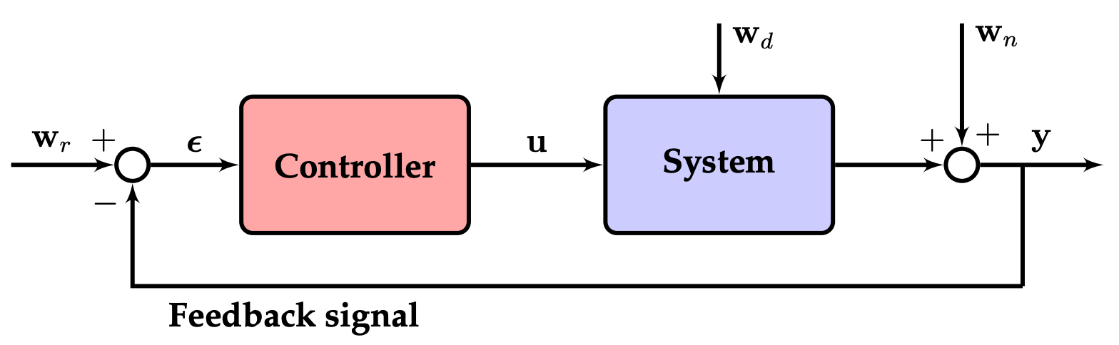
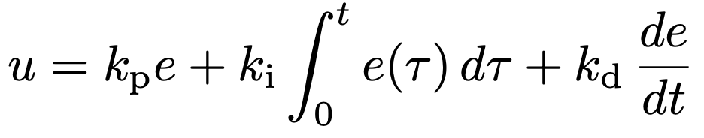

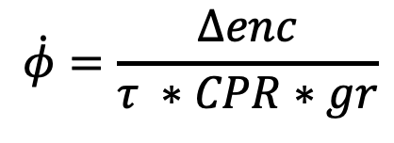
Action: End-to-End Overview
$$Δs=\frac{Δenc}{CPR∗gr}∗c_{wheel}$$
series of poses
$${[ p}_{start}, p_{1},p_{2},p_{…} , p_{end} ]$$
$$p_{i}=[x_{i} , y_{i} , θ_{i}]$$
Path Planning
Kinematics / Odometry
What about speed?
$$\dot{φ}=\frac{Δenc}{τ ∗CPR∗gr}$$
Easiest thing to do / assume: constant linear velocity

Slide 5
Questions?

Slide 6
Class Overview
Lecture (~50 minutes)
Subsystem check-in (~15 minutes)

Slide 7
Perception: Lecture 1 of 2
Lecture 1: sensors → data acquisition
Lecture 2: signal processing → mapping

Slide 8
Lecture Overview: Ascending the Stack
Overview / Taxonomy
Sensor physics
Data acquisition

Slide 9
Sensors: Types and Examples
CLASS
QUANTITY
NAME
LiDAR
Distance
Time-of-flight,
received angle/intensity
Active
Ultrasonic
Infrared
IMU
Intensity
Sound pressure
Image
Humidity
Altimeter /
Barometer
Passive
Microphone
Camera

Slide 10
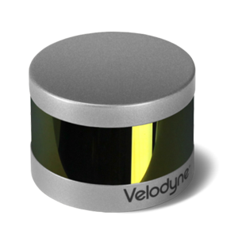
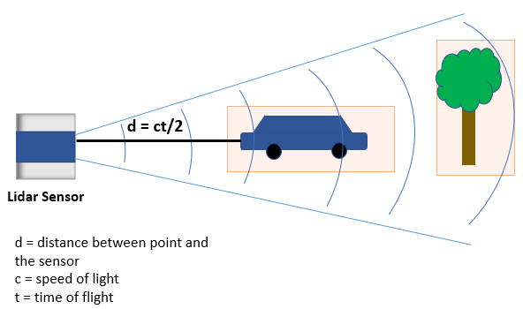
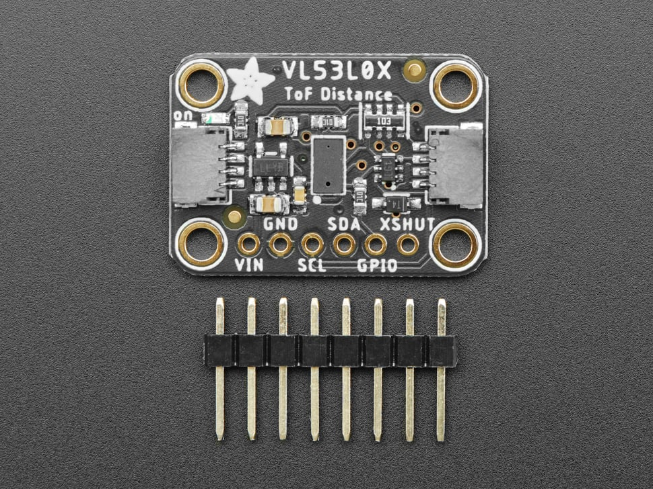
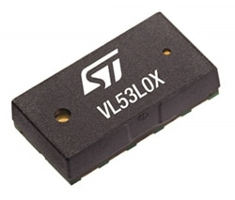
Sensors: Optical Time-of-Flight
Light Detection and Ranging

Slide 11
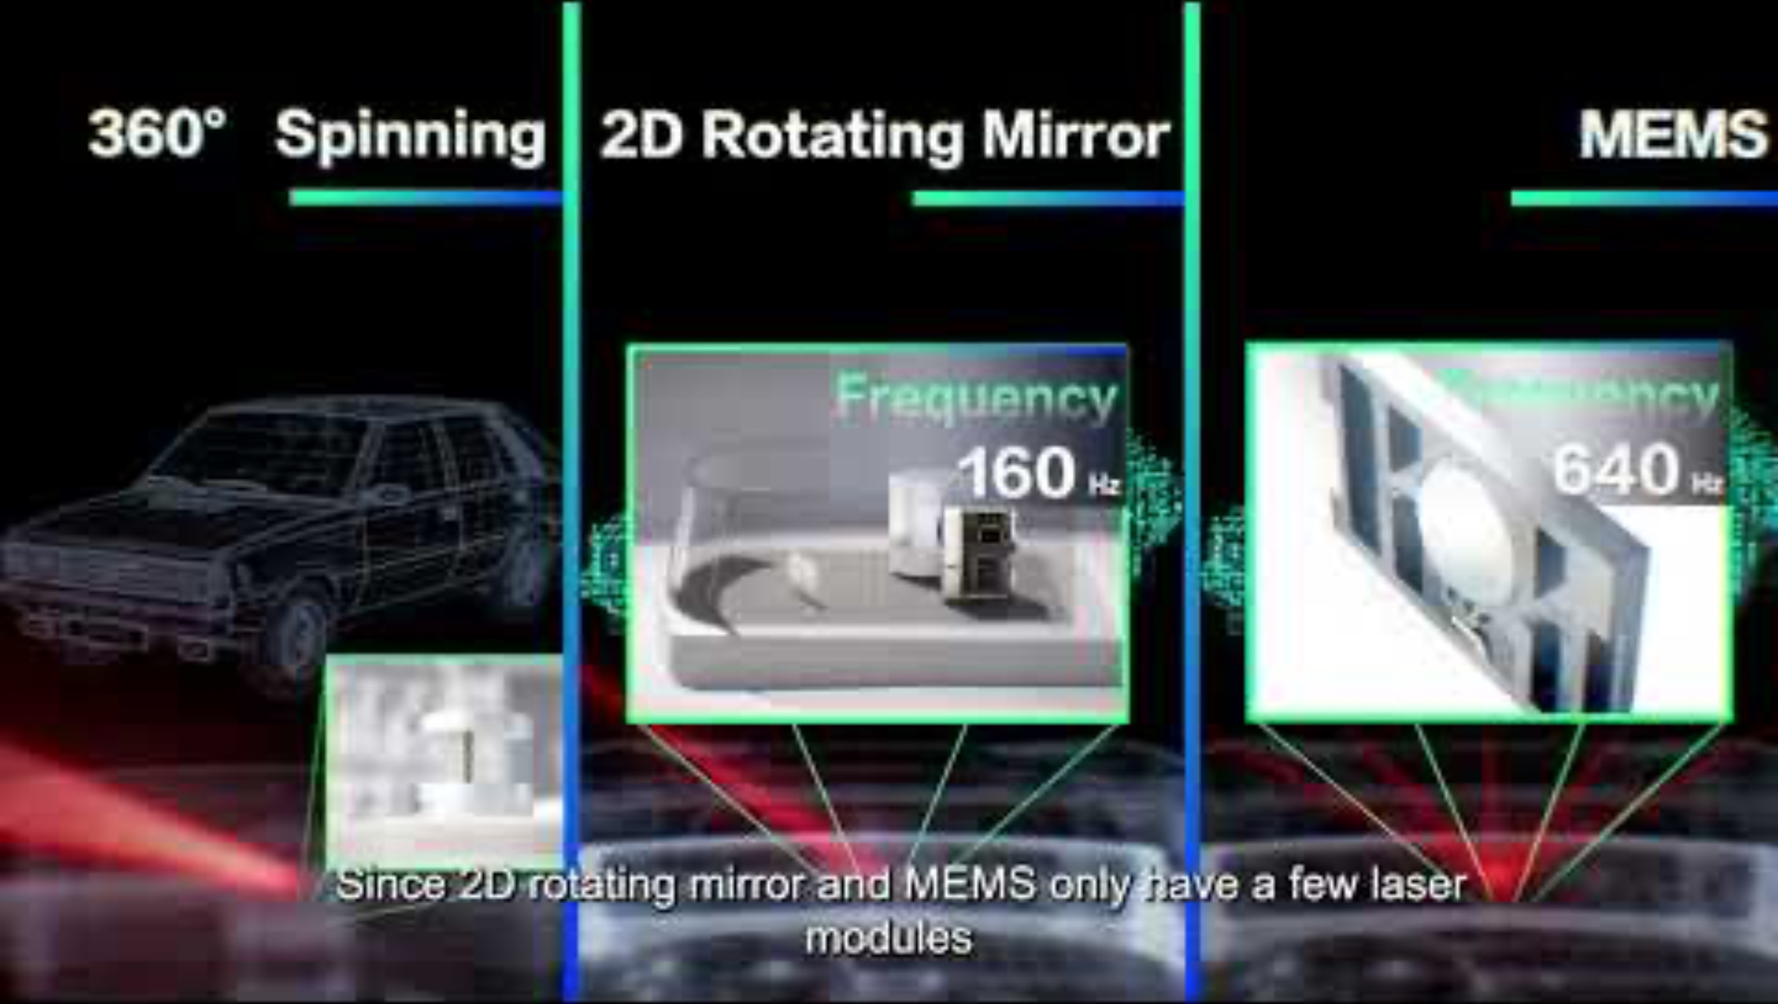
Sensors: Optical Time-of-Flight
3:15

Slide 12
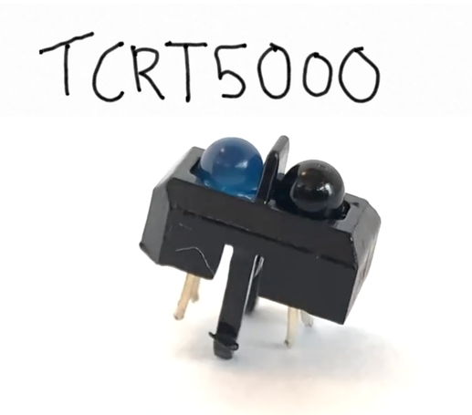
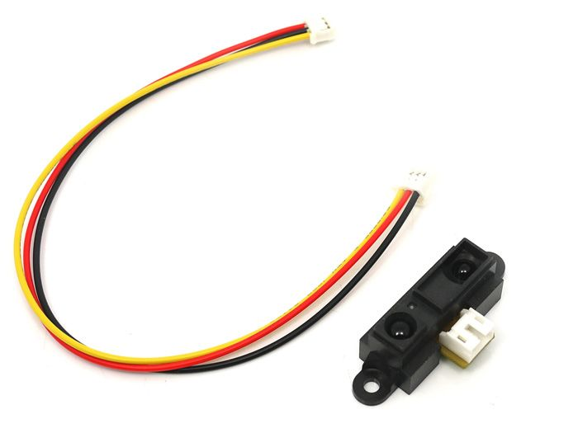
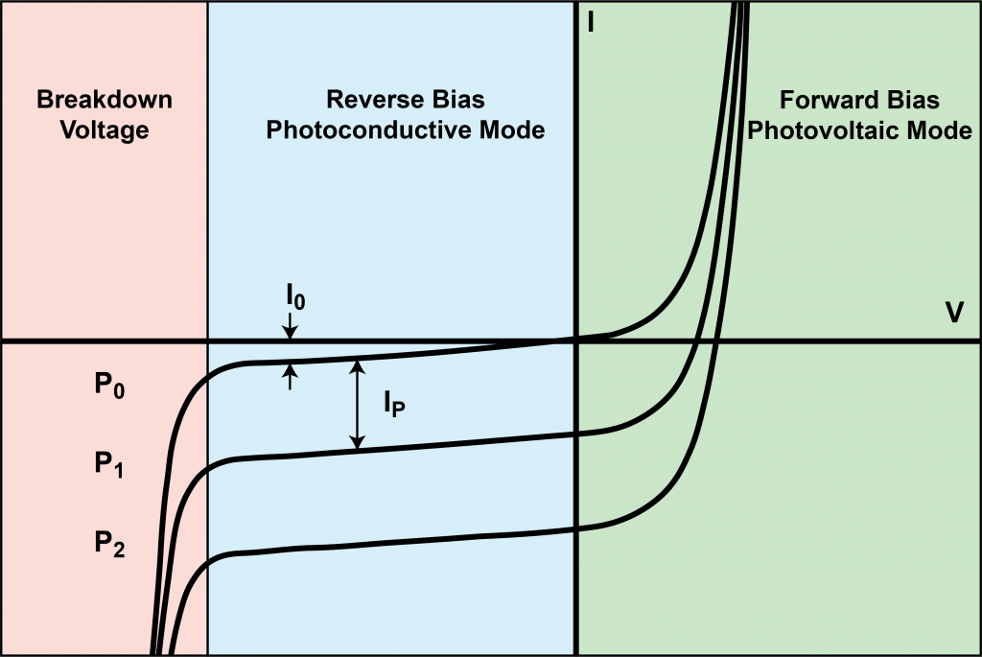
Sensors: Optical Non-ToF
Photodiode

Slide 13
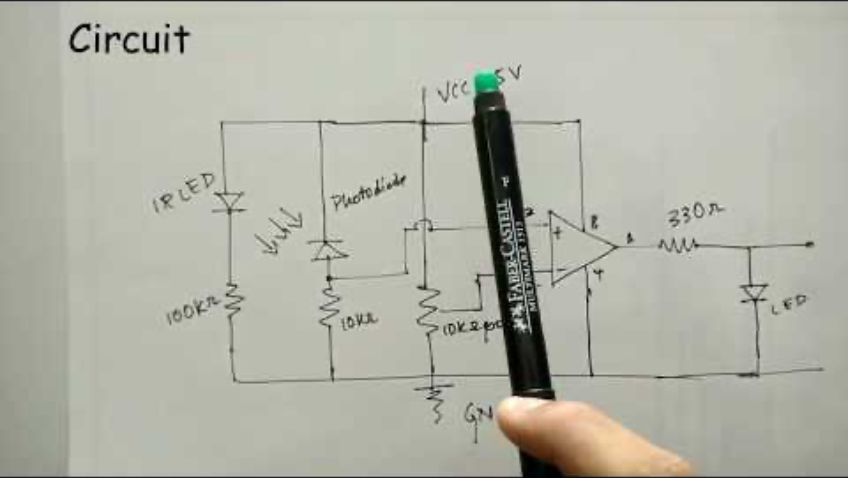
Sensors: Optical Non-ToF
3:00

Slide 14
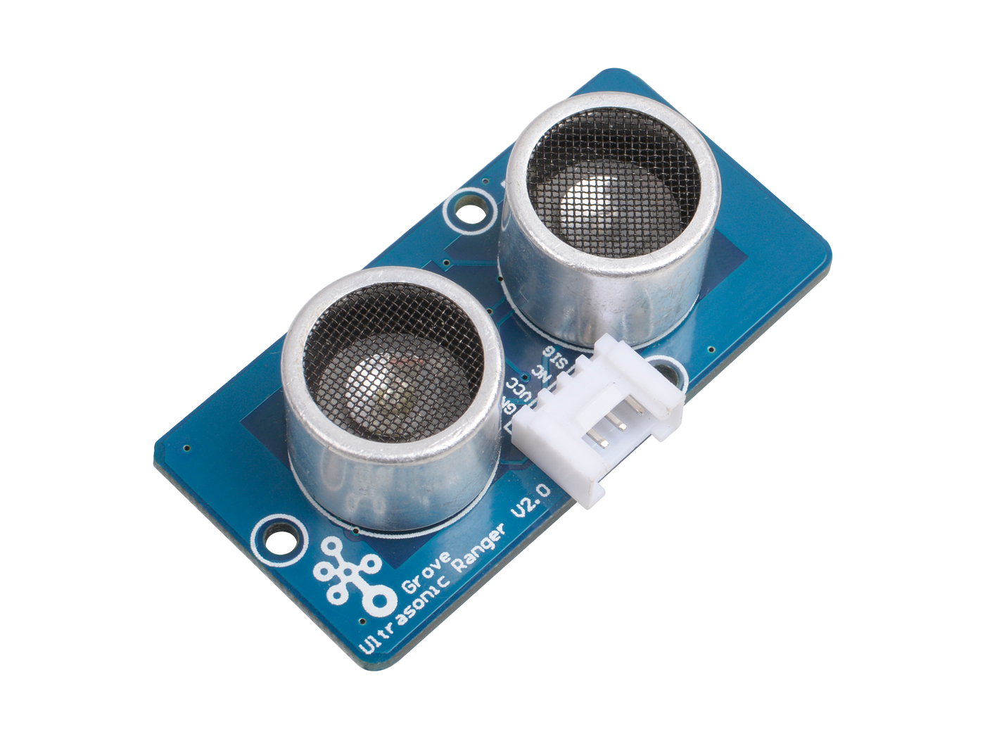
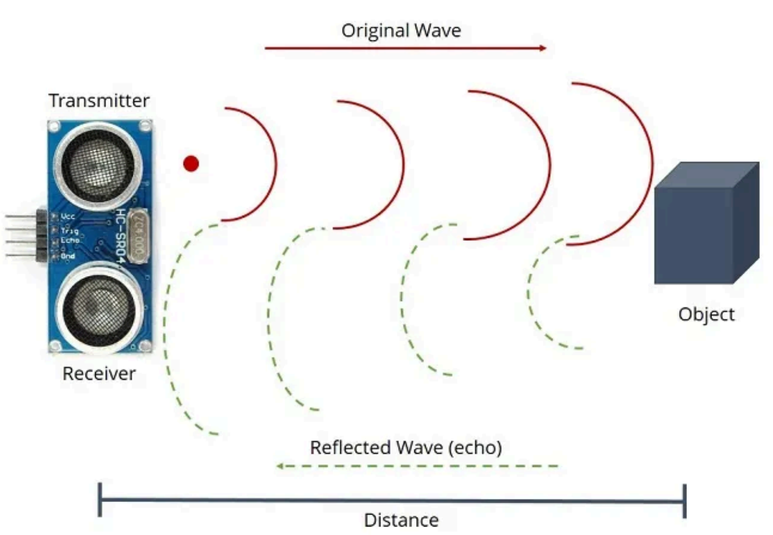
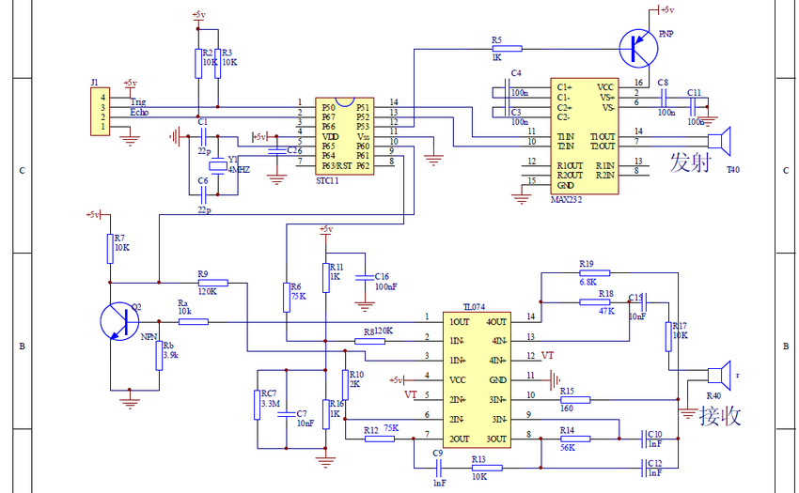
Sensors: Acoustic Time-of-Flight
HC-SR04 (common)

Slide 15
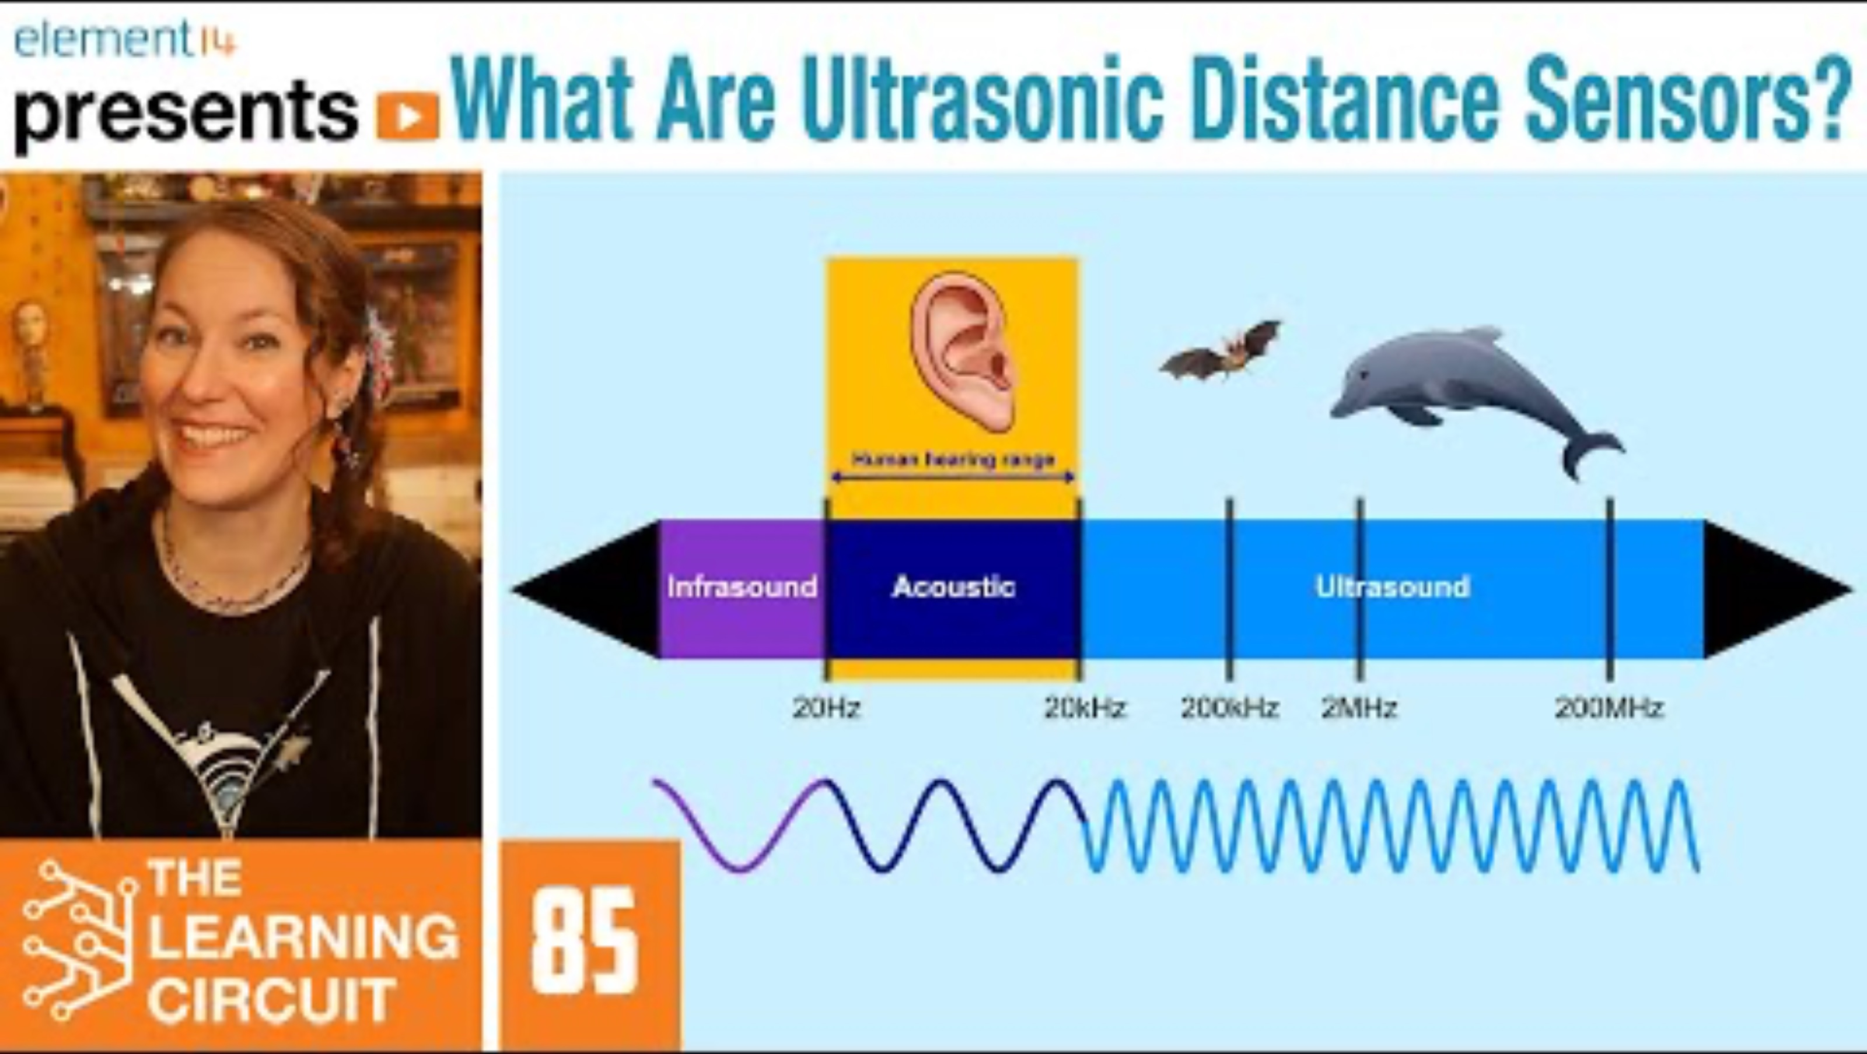
Sensors: Acoustic Time-of-Flight
4:20

Slide 16
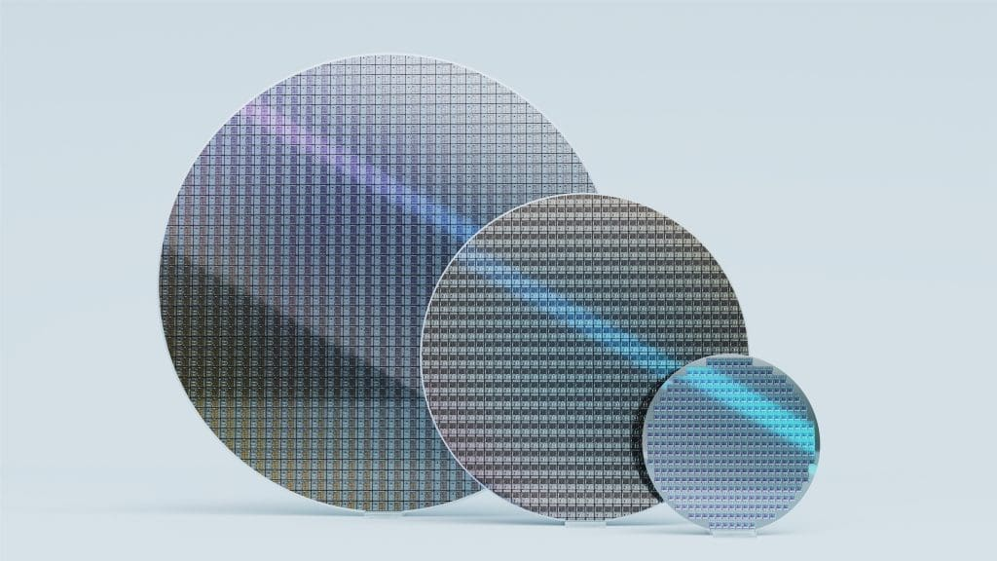
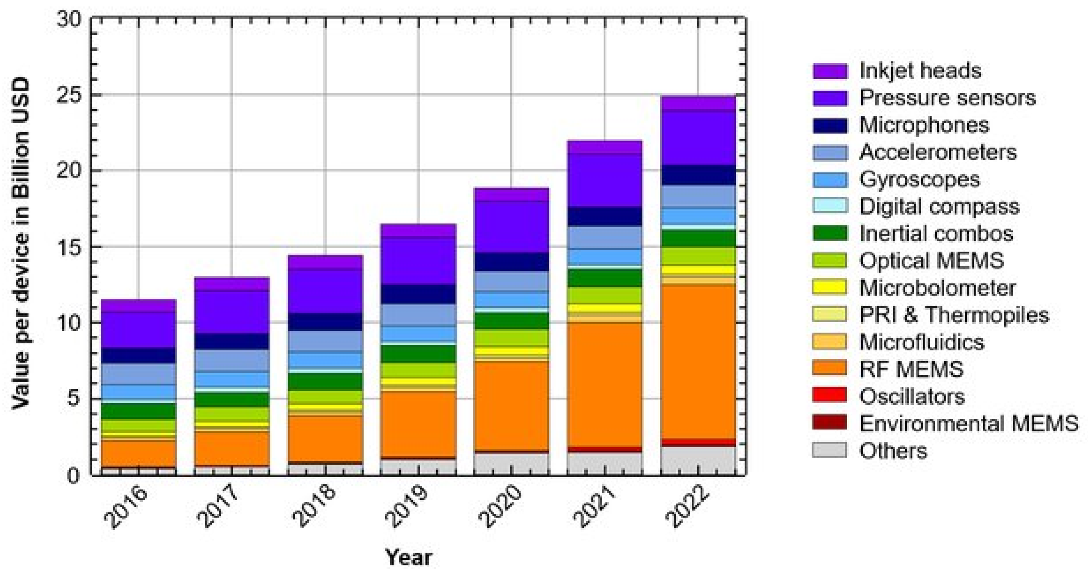
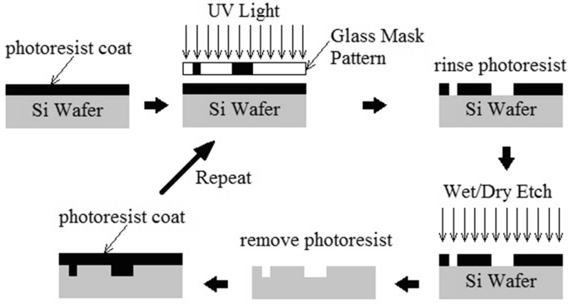
Interlude: Micro Electromechanical Systems (MEMS)

Slide 17
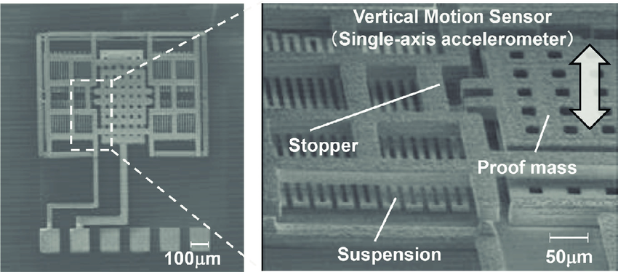
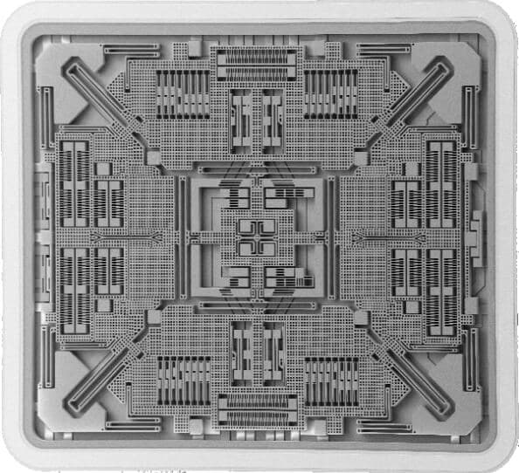
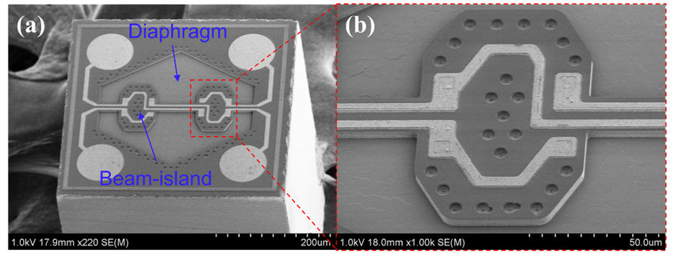
Interlude: Micro Electromechanical Systems (MEMS)

Slide 18

Interlude: Micro Electromechanical Systems (MEMS)
2:05

Slide 19
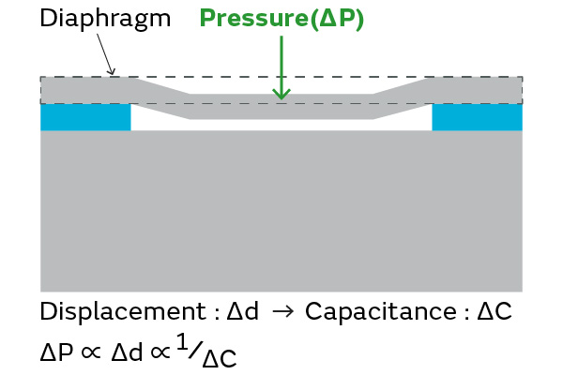
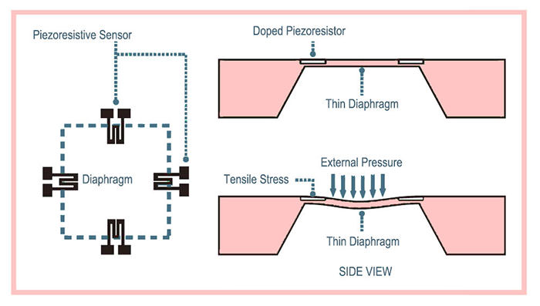
Sensors: Barometer / Altimeter
Piezoresistive Pressure Sensor
Capacitive Pressure Sensor

Slide 20
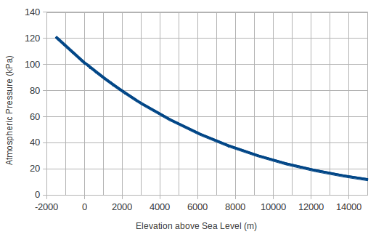
Sensors: Barometer / Altimeter
Piezoresistive Pressure Sensor
Barometer-based altimetry accurate to a few meters

Slide 21
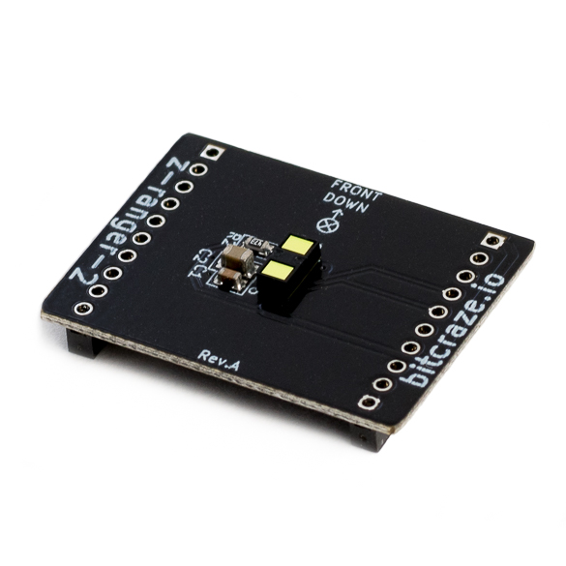
Sensors: Barometer / Altimeter
Piezoresistive Pressure Sensor
Barometer-based altimetry accurate to a few meters
Note: small altimeters are usually optical tof, not pressure;
they fly low enough to not need a barometer

Slide 22
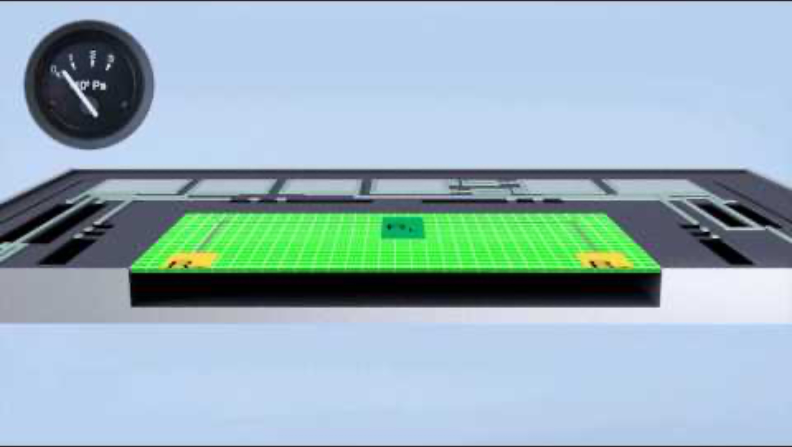
Sensors: Barometer / Altimeter

Slide 23
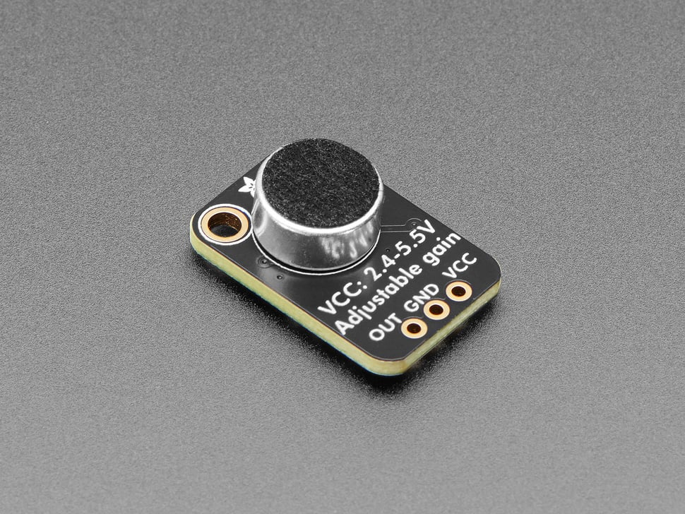
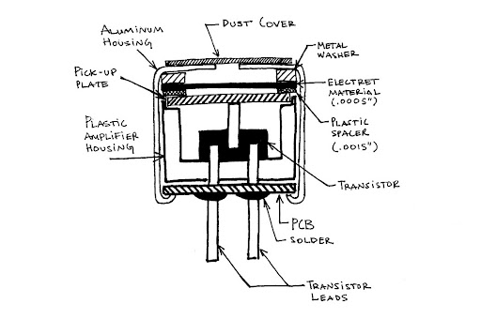
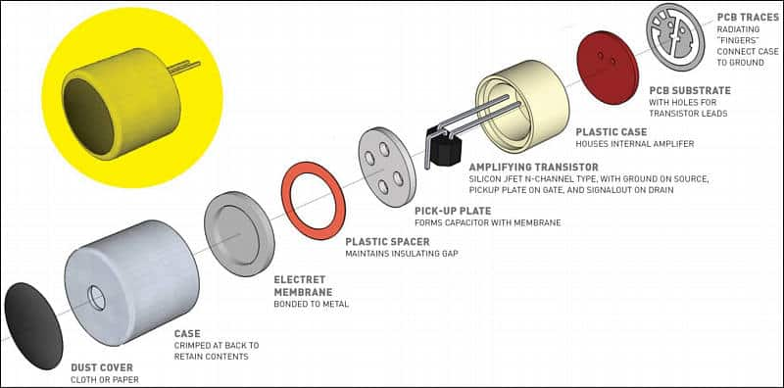
Sensors: Microphones
Electret microphone
Electret materials have a permanent static charge, so capacitor doesn’t need to be externally powered

Slide 24
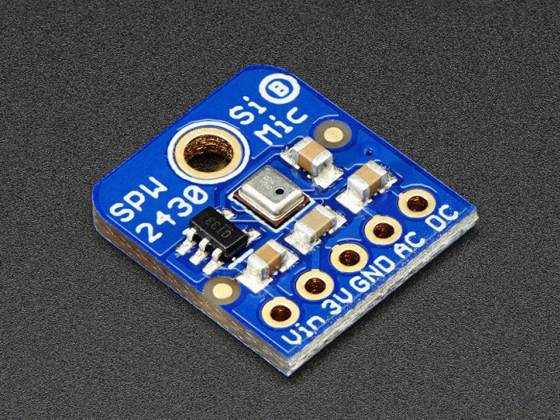
Sensors: Microphones

Slide 25
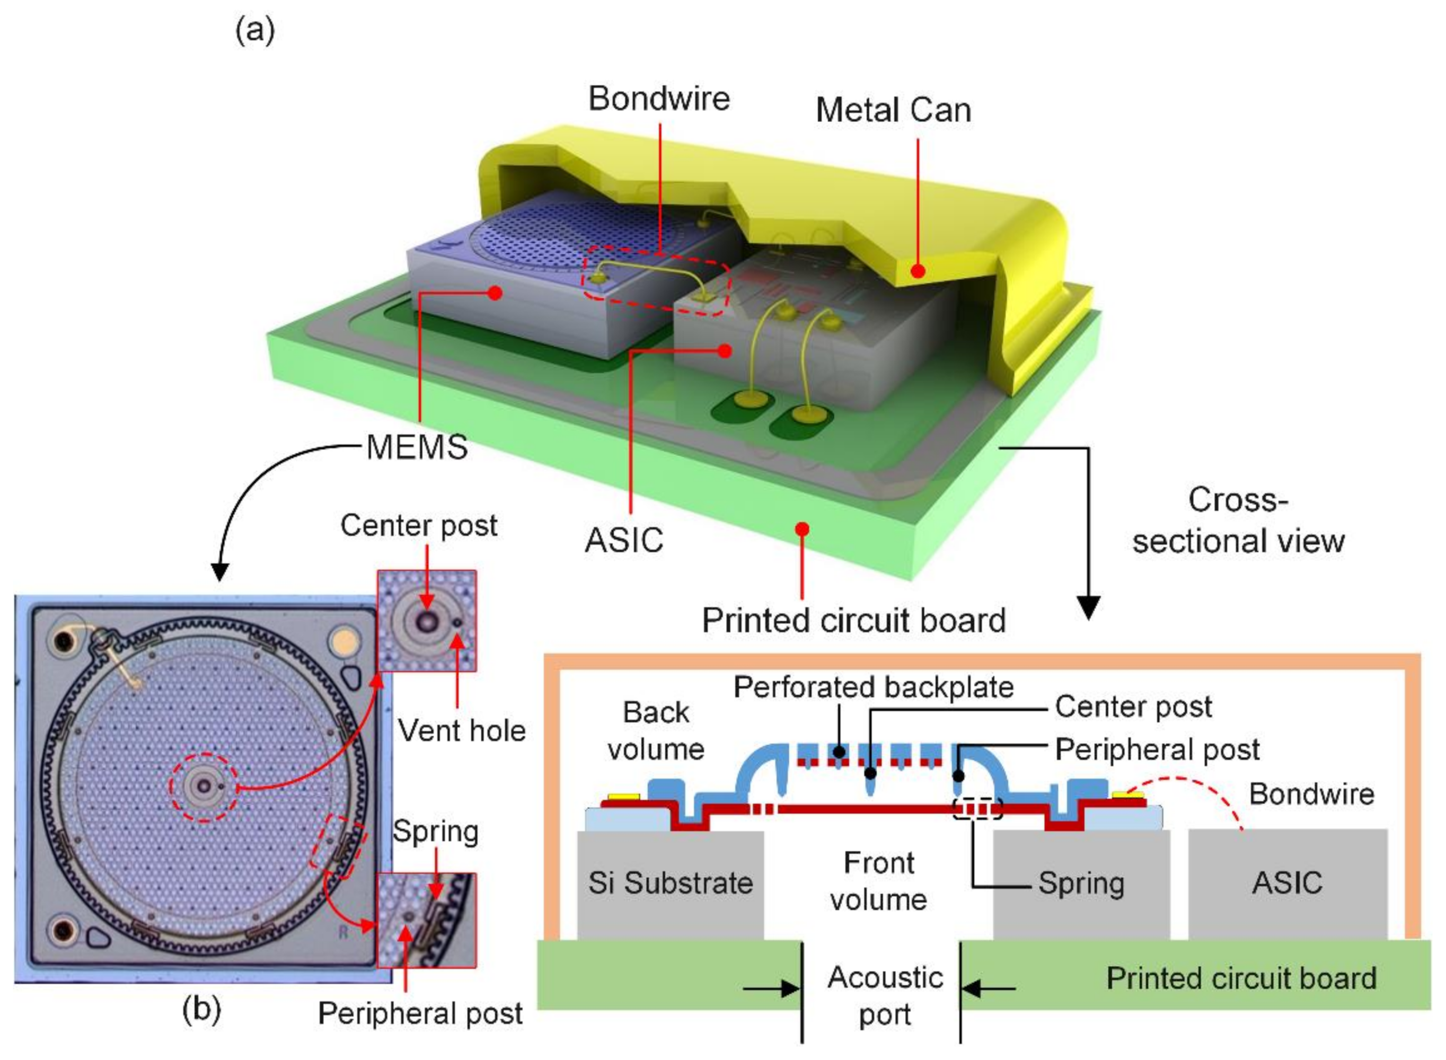

Sensors: Microphones
Inan et al., 2017
Common in mobile devices (e.g., smartphones)

Slide 26





Sensors: MEMS Inertial Measurement Unit
“6-axis IMU” = Accelerometer, gyroscope. “9-axis IMU” = Accel., gyro., magnetometer.
Accelerometer
Gyroscope
$$F=ma$$
$$F_{C}=−2m\left(Ω × v\right)$$

Slide 27


Sensors: MEMS Inertial Measurement Unit
“6-axis IMU” = Accelerometer, gyroscope. “9-axis IMU” = Accel., gyro., magnetometer.
Accelerometer
$$F=ma$$

Slide 28








Sensors: MEMS Inertial Measurement Unit
$F=ma=kx$
$$k_{beam}=\frac{12EI_{b}}{L^{3}}$$
$$I_{b}=\frac{tw^{3}}{12}$$
$$x∝ΔC$$
$$a=\frac{k}{m} x$$
$$C=\frac{ε_{0}A}{d}$$
$k_{tot}=k_{f1}+$ $k_{f2}$ $+ k_{f2}$ ${+ k}_{f2}$

Slide 29


Slide 30



Sensors: Cameras

Slide 31

Sensors: Cameras
2:05

Slide 32
Lecture Overview: Ascending the Stack
Overview / Taxonomy
Sensor physics
Data acquisition
Many sensors involve a TRANSDUCTION from the physical quantity to a change in resistance, capacitance, or stored charge
How do we turn this into data in our computer?

Slide 33

Readout Circuitry: Wheatstone Bridge
Many transducers output a change in resistance:
e.g., piezoresistive pressure sensors, strain gauges, load cells, thermocouples
Wheatstone bridges can:
-Increase sensitivity
-Compensate for environmental factors
-Allow for fully differential measurement

Slide 34

Readout Circuitry: Wheatstone Bridge
5:14

Slide 35



Readout Circuitry: Op. and Inst. Amplifiers
WHY USE AN AMPLIFIER?
Typical voltage output of a strain sensor is mV
Mainly interested in differential signals (e.g., Wheatstone bridge)
Prevent loading of sensor circuit
e.g., piezoelectric sensors, microphones, strain gauges, thermocouples
Infinite open-loop gain, infinite input impedance, voltage difference between inputs is zero
op-amp in negative feedback

Slide 36





Analog-to-Digital Conversion: Basic Concept
Output of sensor readout circuits is (almost always) an analog voltage
How do we convert this into something readable by a computer? (digital info)
“full-scale”
(typ. VCC of ADC)
“3-bit” ADC:
000 to 111 in binary
0 to 7 in decimal
Either built into your microcontroller (e.g., ESP32)
OR purchased as discrete IC (only when needed)
e.g., Successive Approximation Register (SAR)
Delta-Sigma, Flash
Resolution = $\frac{V_{ref}}{2^{N}}$
$$\frac{3.3V}{2^{3}}=410mV$$
$$\frac{3.3V}{2^{10}}=3mV$$

Slide 37

Analog-to-Digital Conversion: Video
4:50

Slide 38
Lecture (~50 minutes)
Subsystem check-in (~15 minutes)
Questions?
Questions?
Lecture 1: sensors → data acquisition
Lecture 2: signal processing → mapping

Slide 39

693H Robotic Subsystems
REMINDERS:
-PARTS ORDER DUE 2/3
-First Design Review Presentations are 2/10, 2/12
-I will randomly select which two groups present which day. Be ready on 2/10.
-Poll: DIY Powerpoints or Google Slides with (loose) templating?

